Slide 1
Introduction to Python
Abhijeet Karve
Assistant Professor
IT Department, PICT, Pune

Slide 2
Python Programming
History
Feature of Python
Easy to code
Open Source
Object-Oriented Language
GUI Programming Support
High-Level Language
Extensible feature
Python is Portable language
Python is Integrated language

Slide 3
Applications of Python
Web Development
Game Development
Scientific and Numeric Applications
Artificial Intelligence and Machine Learning
Software Development
Enterprise-level/Business Applications
Education programs and training courses
Language Development

Slide 4
IDE vs Code Editors
PyCharm
Coding Assistance
Built-in Tools (Developer Tools)
Web Development
Jupyter
CodeEditor
Able to print output on the same screen
Editable Json format can be edited in any editor

Slide 5
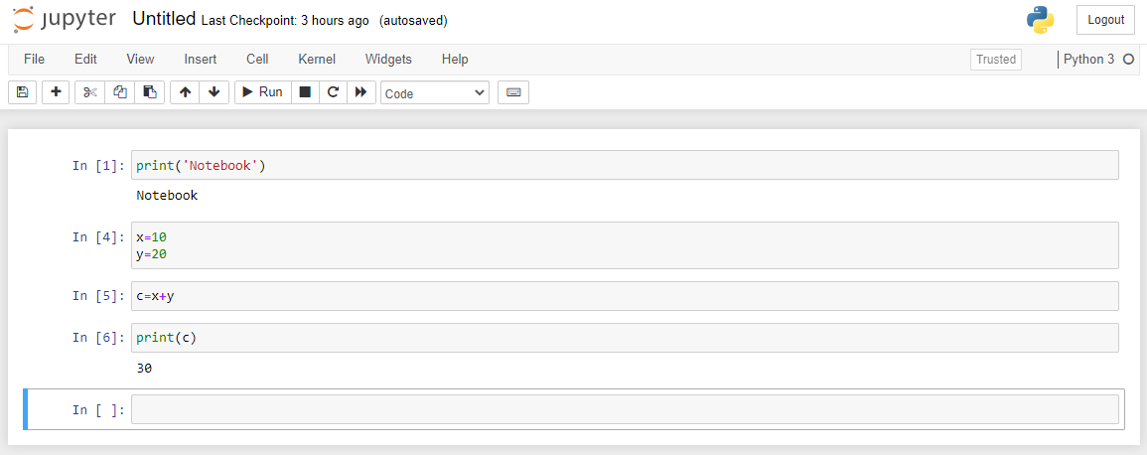
Writing and executing a Python Script

Slide 6
Basic Programming
Print Variable
Take Input
Print Output
Tasks

Slide 7
Conditional Execution in python
If loop
If else
If elif…else
Nested if
Tasks

Slide 8
If else Tasks
Input three numbers and find the largest
Input six numbers and find the largest and smallest
Write a code to create calculator

Slide 9
Looping structures in Python
Usage of For Loop
For a in range(4)
For a in range(0,10)
For a in range(0,10,2)

Slide 10
For loop tasks
Print table of a number up to 10
Find factorial of a number using for loop

Slide 11
Mathematical Operators in Python
+ | Simple Addition | A + B | Gives simple addition
- | Simple Subtraction | A – B | Gives simple subtraction
* | Multiplication | A * B | Gives simple multiplication
/ | Floating point Division | A / B | 5/2 will be 2.5
% | Modulus | A % B | Give remainder of division
** | Exponentiation | A ** B | A to the power of B
// | Floor division | A // B | 5 // 2 will be 2

Slide 12
While loop in Python
Similar to for
Only condition is specified in while
Increment and decrement need to be done inside loop
a = 0
While a < 10:
print(“a = “, a )
a = a + 1

Slide 13
Tasks for while
Write a python program to print square of all numbers from 1 to 10
Find the sum of all even numbers between 0 to 10
Write a python program to read the numbers (x,y,z) and check how many of them are between 10 and 100.
Accept a number and find reverse of it.
Input: 7845 is the number entered by user
Output: 5487

